Slide 1
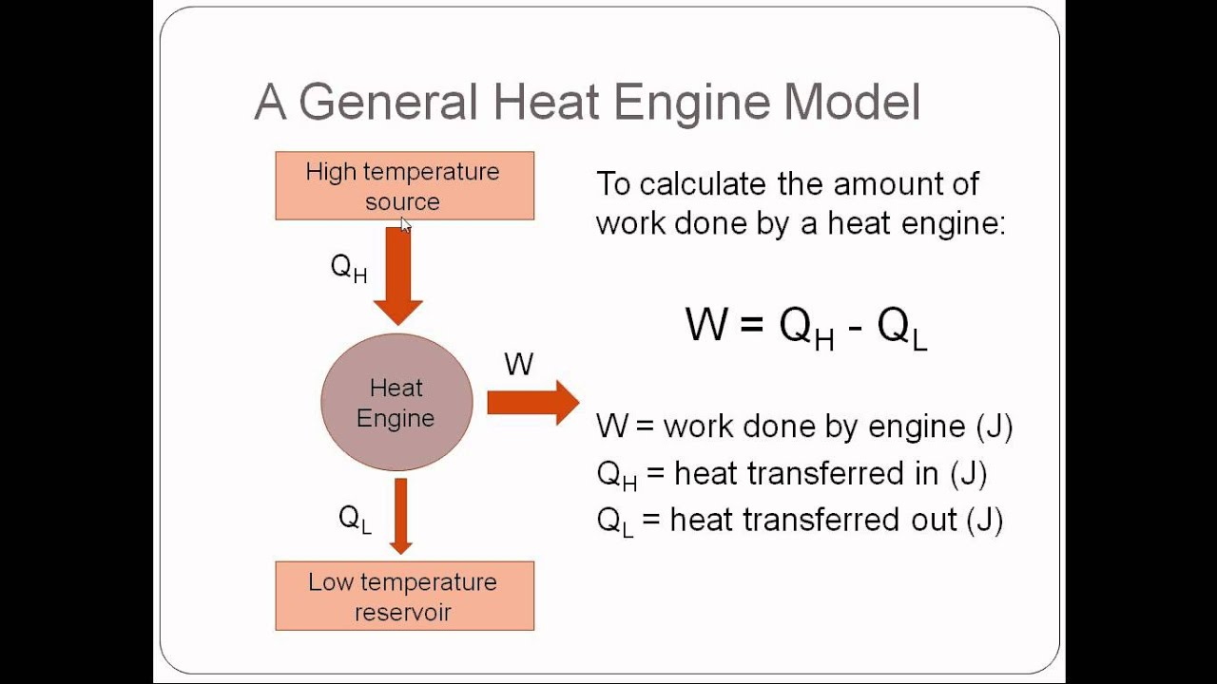
Heat Engine

Slide 2
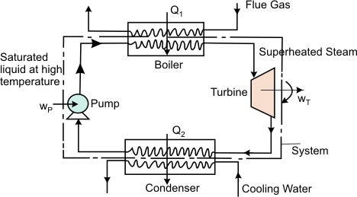
Heat Engine
A heat engine is a device which converts the energy it receives at heat, into work.
It is a cyclically operating device.
It receives energy as heat fr0m a high temperature body, converts part of it into work and rejects the rest to a low temperature body.
A thermal power plant is an example of a heat engine.

Slide 3
Heat Engine
Figure describes a basic arrangement of a thermal power plant
In the boiler, the working fluid receives a certain amount of heat Q1 from the hot combustion products.
The superheated steam enters a turbine where it undergoes expansion performing the shaft work Wt
The low pressure steam enters a condenser where it exchange energy as heat at constant pressure with the cooling water and emerges as the condensate. The condensate rejects a certain amount of heat Q2 to the cooling water.
The low pressure condensate from the condenser enters the pump. Work Wp is done on the pump to elevate the condensate to the boiler pressure and return it to the boiler.

Slide 4
Heat Engine
In the above example,
Work done by the system
Energy absorbed as heat by the system = Q1
Energy rejected as heat by the system = Q2
According to first law of thermodynamics, the heat and work interaction are related by the equation.

Slide 5




Heat Engine
Finally, the thermal efficiency of a heat engine can be expressed as

Slide 6
Heat Pump
Heat Pump is cyclically operating device which absorbs energy from a low temperature reservoir and reject energy as heat to a high temperature reservoir when work is performed on the device.
Its objective is to reject energy as heat to a high temperature body (space heating in winter). The atmosphere acts as the low temperature reservoir.

Slide 7
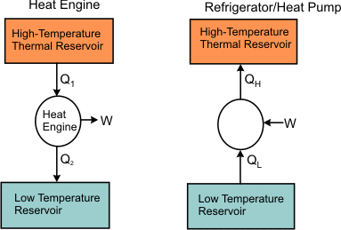
Refrigerator
A refrigerator is a cyclically operating device which absorbs energy as heat from a low temperature body and rejects energy as heat to a high temperature body when work is performed on the device. The objective of this device is to refrigerate a body at low temperature. Usually it uses atmosphere as the high temperature reservoir.

Slide 8
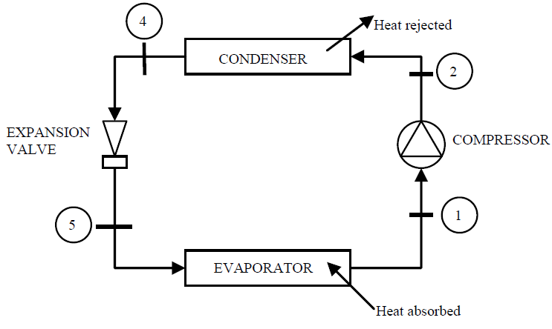
Refrigerator

Slide 9


Refrigerator
Refer to refrigerator figure. Let and represents the amount of energy absorbed as heat from the low temperature reservoir and the energy rejected as heat to the high temperature reservoir respectively, Let W be the work done on the device to accomplish the task.

Slide 10

Refrigerator
The efficiency of a heat engine is given by
since (heat) transferred to the system cannot be completely converted to work in a cycle. Therefore is less than unity. A heat engine can never be 100 efficient. Therefore i.e., there has always to be a heat rejection. Thus a heat engine has to exchange heat with two reservoirs, the source and the sink. This experience leads to the proposition of the second law of thermodynamics which has been stated in several different ways.

Slide 11
Kelvin Planck Statement of the Second Law
It is impossible to construct a cyclically operating device such that it produces no other effect than the absorption of energy as heat from a single thermal reservoir and performs an equivalent amount of work.
The only option then is that the engine converts part of the energy it receives as heat into work and rejects the rest to another thermal reservoir the temperature of which is less than the temperature of the source.
Two thermal reservoirs, one of high temperature (source), from which the working fluid receives energy as heat, and the other of low temperature (sink), to which the working fluid rejects energy as heat, are needed for a heat engine.
Once the heat engine rejects a part of the energy it receives, its efficiency becomes less than one.
Thus the Kelvin Planck statement further implies that no heat engine can have a thermal efficiency of one (hundred percent). This does not violate the first law of thermodynamics either

Slide 12
Kelvin Planck Statement of the Second Law
Second law restricts the thermal efficiency of a heat engine to less than one. It stipulates that some portion of the energy absorbed as heat from a source must always be rejected to a low temperature sink.
Wilhelm Ostwald introduced the concept of perpetual motion machine of the second kind (PMMSK or PMM2), that is, of a device which would perform work solely by absorbing energy as heat from a body. Such a device does not violate the first law of thermodynamics.
A PMMSK is a hypothetical device which working cyclically, receives energy as heat from a single thermal reservoir, and delivers as equivalent amount of work. The Kelvin-Planck statement of the second law tells us that it is impossible to constructs a perpetual motion machine of the second kind.

Slide 13
Clausius Statement of the Second Law
Heat always flows from a body at higher temperature to a body at a lower temperature. The reverse process never occurs spontaneously.
Clausius' statement of the second law gives: It is impossible to construct a device which, operating in a cycle, will produce no effect other than the transfer of heat from a low-temperature body to a high temperature body.
This statement tells us that it is impossible for any device, unaided by an external agency, to transfer energy as heat from a cooler body to a hotter body. Consider the case of a refrigerator or a heat pump

Slide 14
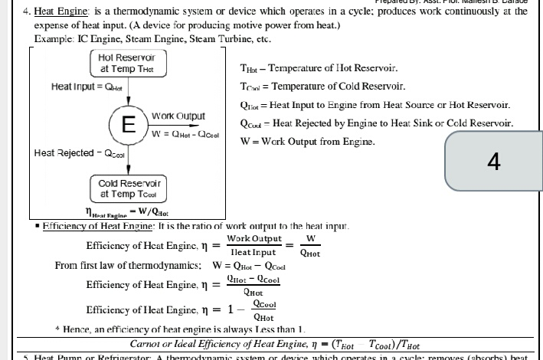

Slide 15
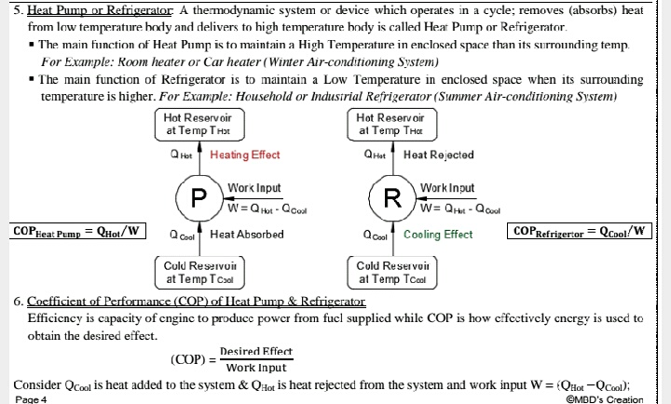

Slide 16
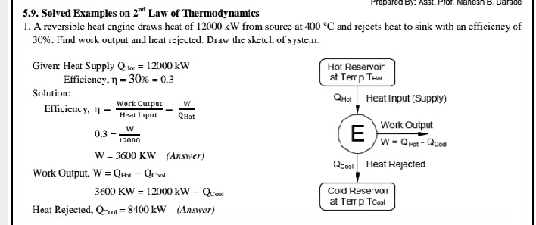

Slide 17
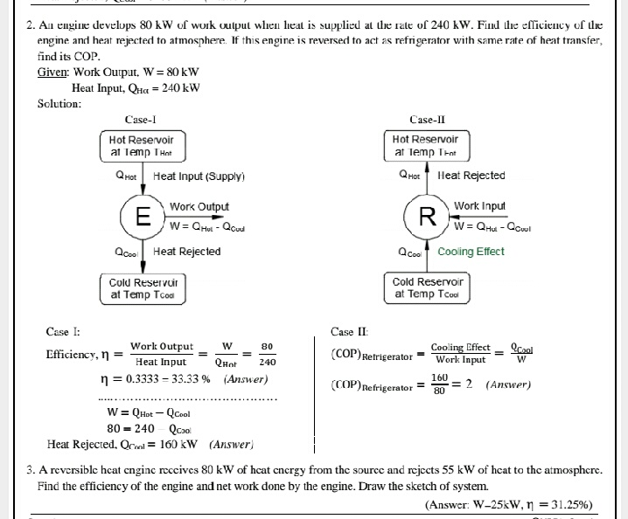

Slide 18
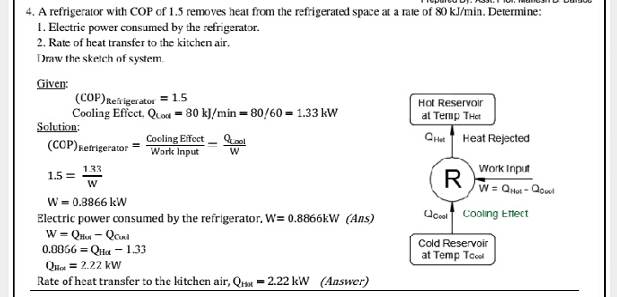

Slide 19
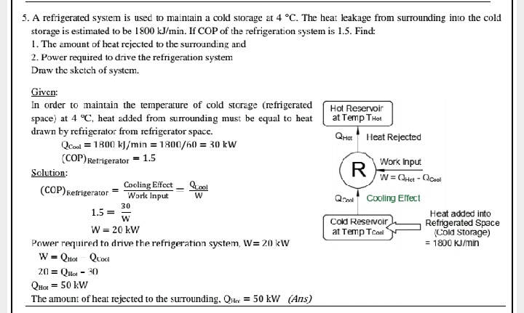

Slide 20
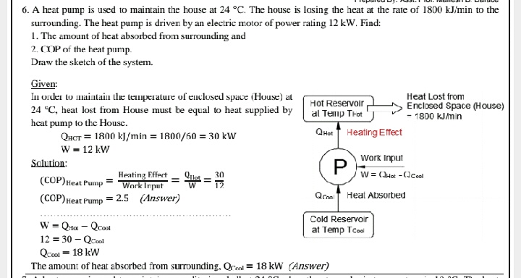

Slide 21

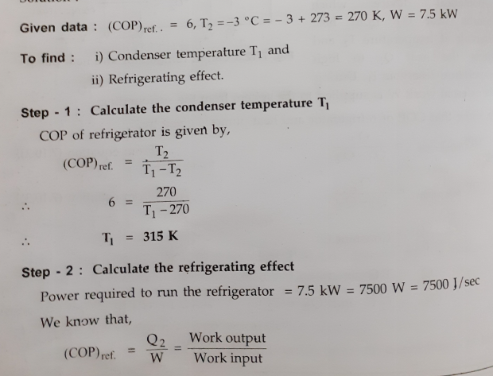
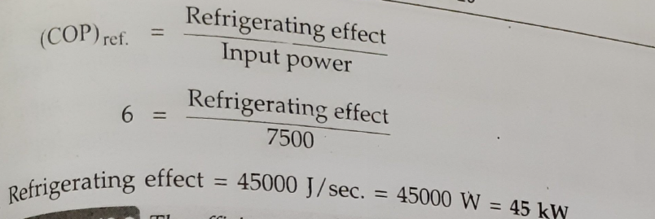

Slide 22
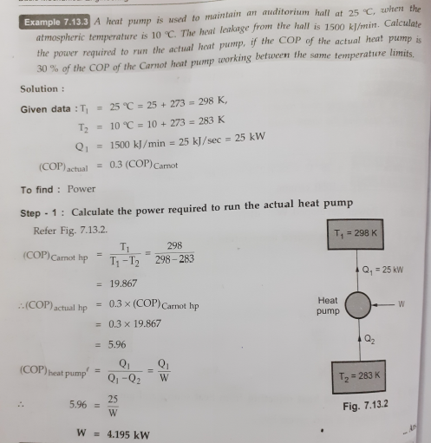

Slide 23
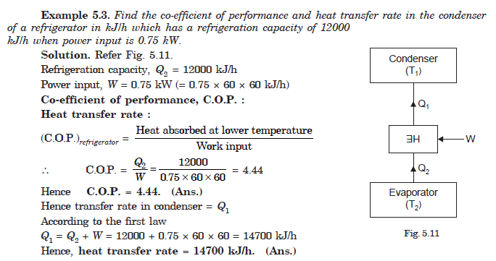

Slide 24
